Slide 1
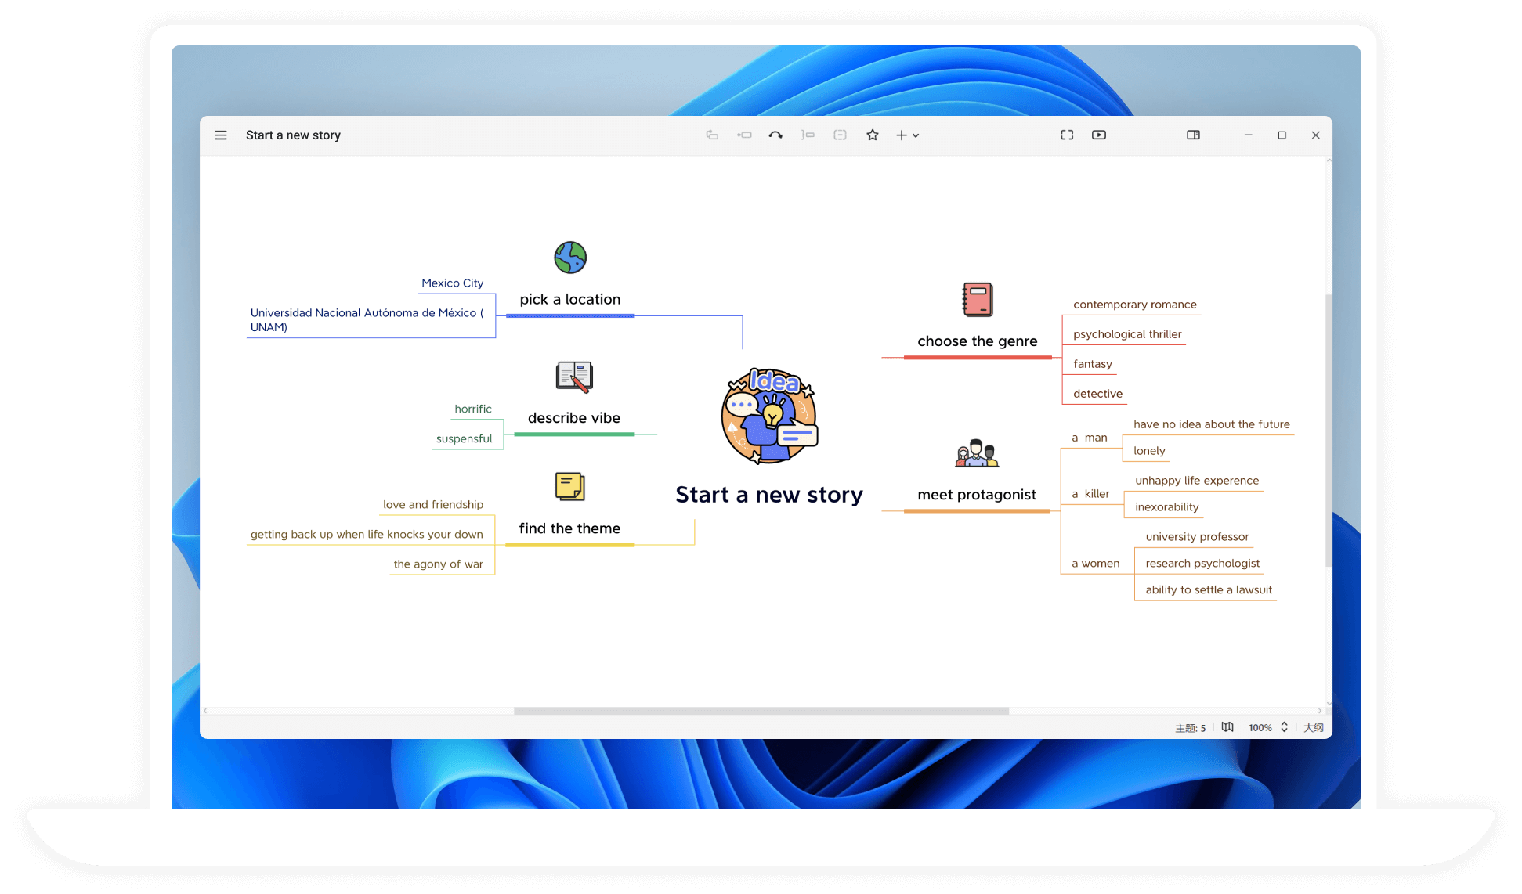







Xiaomi Qeeper

Slide 2
Samanea Hill

Slide 3
Scylla - CMS

Slide 4
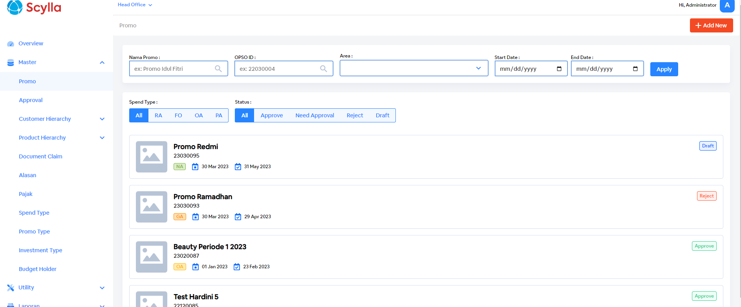
Scylla - CMS

Slide 5
Ravindra
Putrapratama

Slide 6
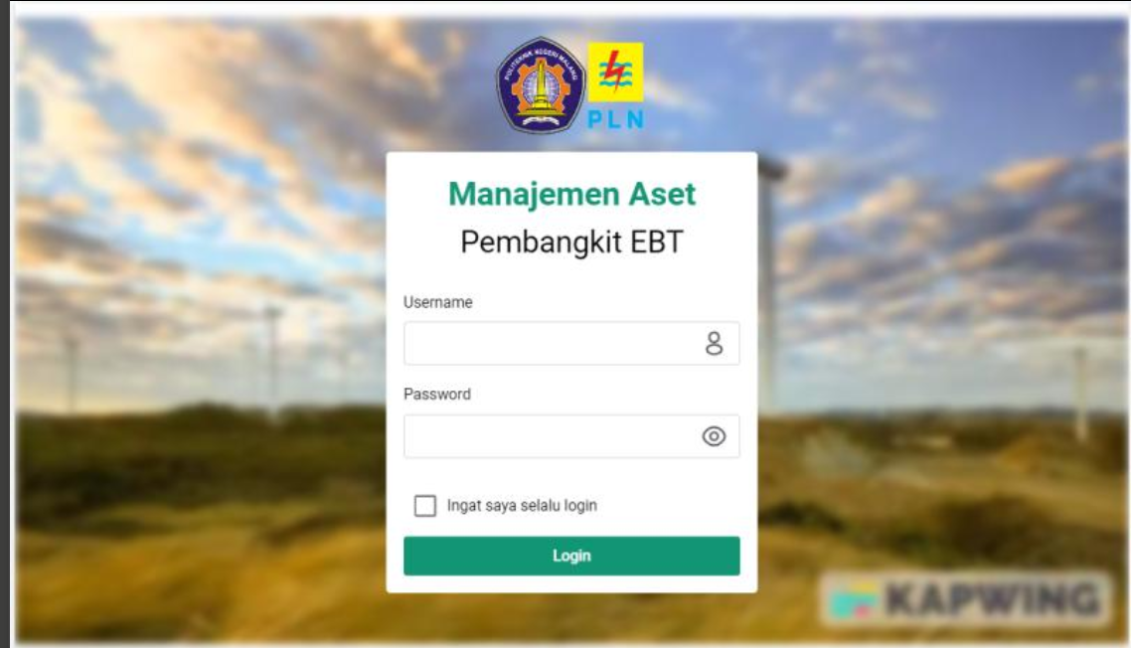
Manajemen Aset Pembangkit EBT
pbt plant asset management based vue js, quasar framework

